Slide 1
University of Borås

Slide 2
Together, we take responsibility for the future
Through continually developing distinctive education and research, we make a difference.

Slide 3
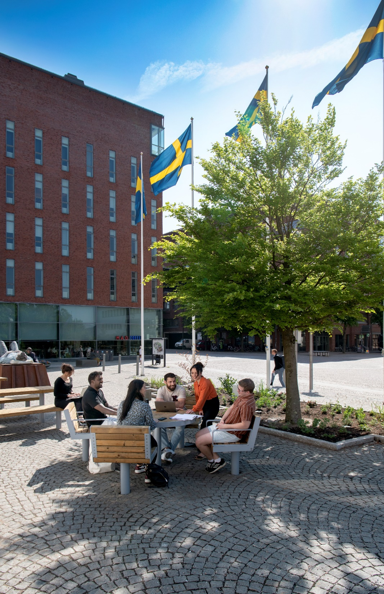
Our goals
The attractive university
Complete academic environments 2.0

Slide 4
Strategies in connection to the university’s goals
Digitalisation
Continually developing distinctive education and research
Environments for learning
Together and in collaboration

Slide 5
In central Borås, Sweden
City campus – a place to meet

Slide 6
The University of Borås offers interdisciplinary educational programmes at the Bachelor’s and Master’s levels as well as doctoral programmes.

Slide 7
Our areas of education
Behavioural and Education Sciences
Business and Informatics
Engineering
Fashion and Textile Studies
Health Sciences
Library and Information Science
Police Education
Work Life and Social Welfare

Slide 8
The home of Scandinavian textiles
The Swedish School of Textiles dates back to 1866 when the Technical School of Weaving was founded. Today, the Swedish School of Textiles offers some of the world’s most prominent educational programmes in the fields of design, technology, and management.
Students have the opportunity to combine creativity, practice, and theory. In the modern machine halls, there are knitting machines, advanced 3D technology, textile printing facilities, and dyeing laboratories.

Slide 9
The book, the web and the future
The Swedish School of Library and Information Science was founded in 1972 and offers internationally renowned education and research in library and information science.
Research is conducted in four main areas:
Information Practices
Knowledge Infrastructure
Libraries, Culture, and Society
Social Media Studies

Slide 10
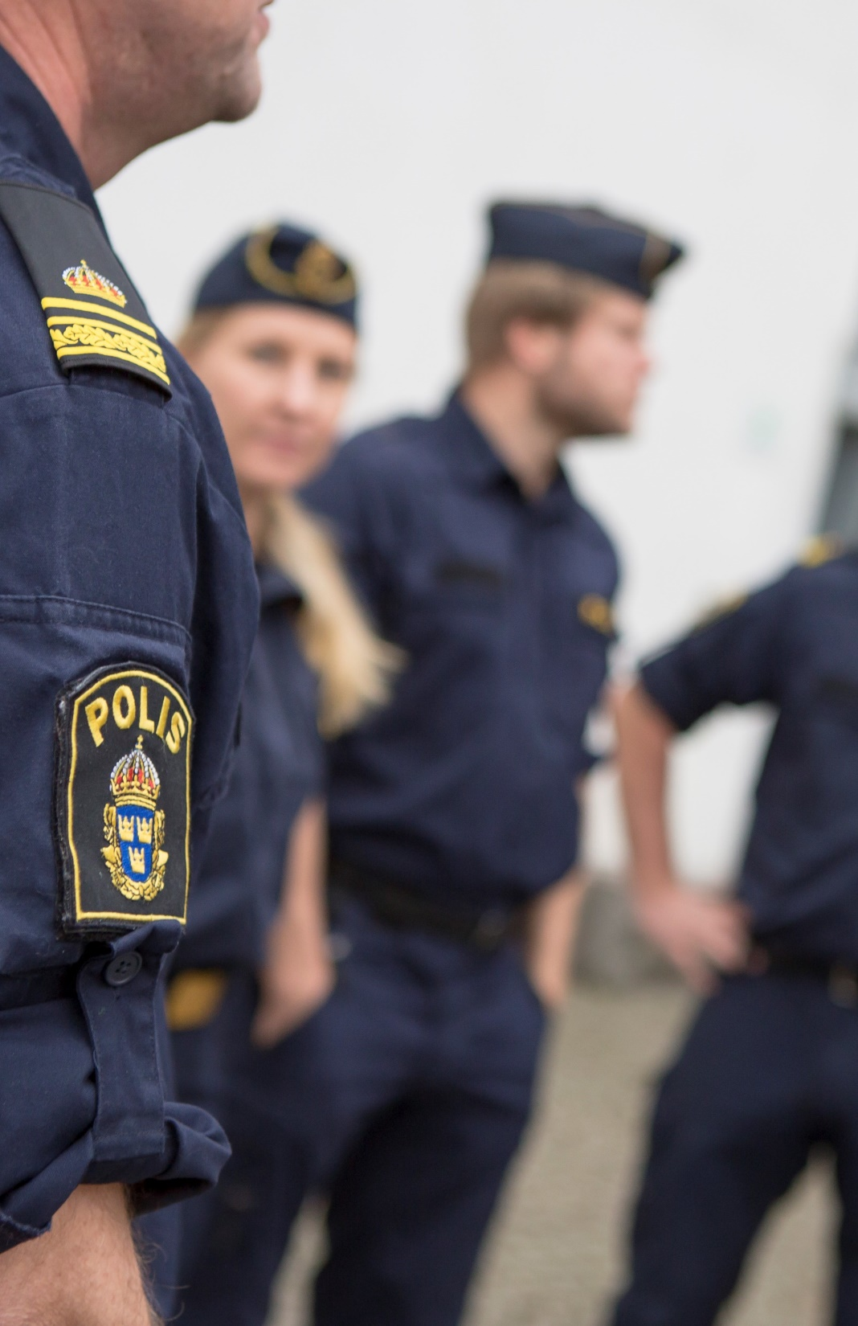
The starting point for the police of the future
The University of Borås is home to a police education programme, both distance and on campus. This is a contract education programme given on behalf of the Swedish Police Authority.

Slide 11
Research that changes society
Research at the University of Borås is unique and focuses on sustainability.
Five rights to grant doctoral degrees in four areas:
Library and Information Science
Resource Recovery
Textiles and Fashion (both design and general)
The Human Perspective in Care

Slide 12
Research that changes society
Research at the University of Borås is unique and focuses on sustainability.
Doctoral education programmes in:
Business and IT
Teacher Education
Educational Work
… are conducted in collaboration with partner universities.

Slide 13
Centres
Strategically important for collaborating with society at large.
Centre for Digitalisation
Centre for Sustainable Society Development
Centre for Cultural Policy Research
Centre for Welfare Studies
PreHospen – Centre for Prehospital Research
INCLUDE – Centre for Inclusive Studies

Slide 14
The university in figures
Number of students: about 19,000
Number of full-time students: 6,488
Number of degrees: 1,787
Number of employees: 828
Number of professors: 49
Number of admitted doctoral students: 90
Turnover kSEK: 963,897

Slide 15
University of Borås

